Slide 1

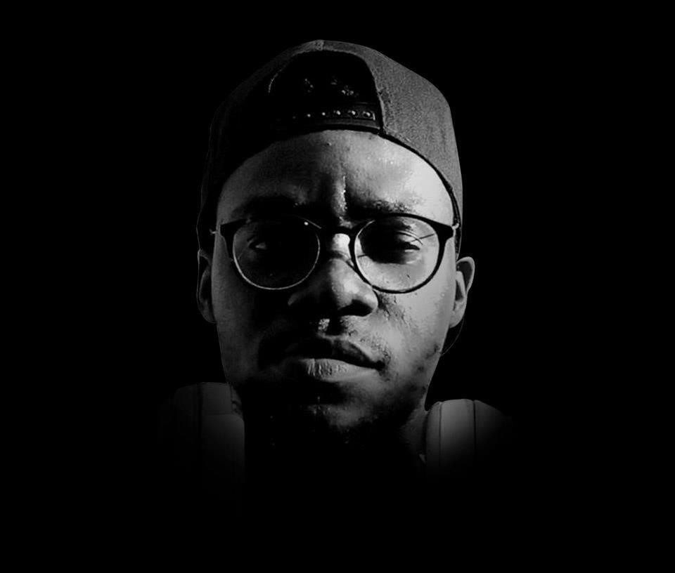





v

Slide 2
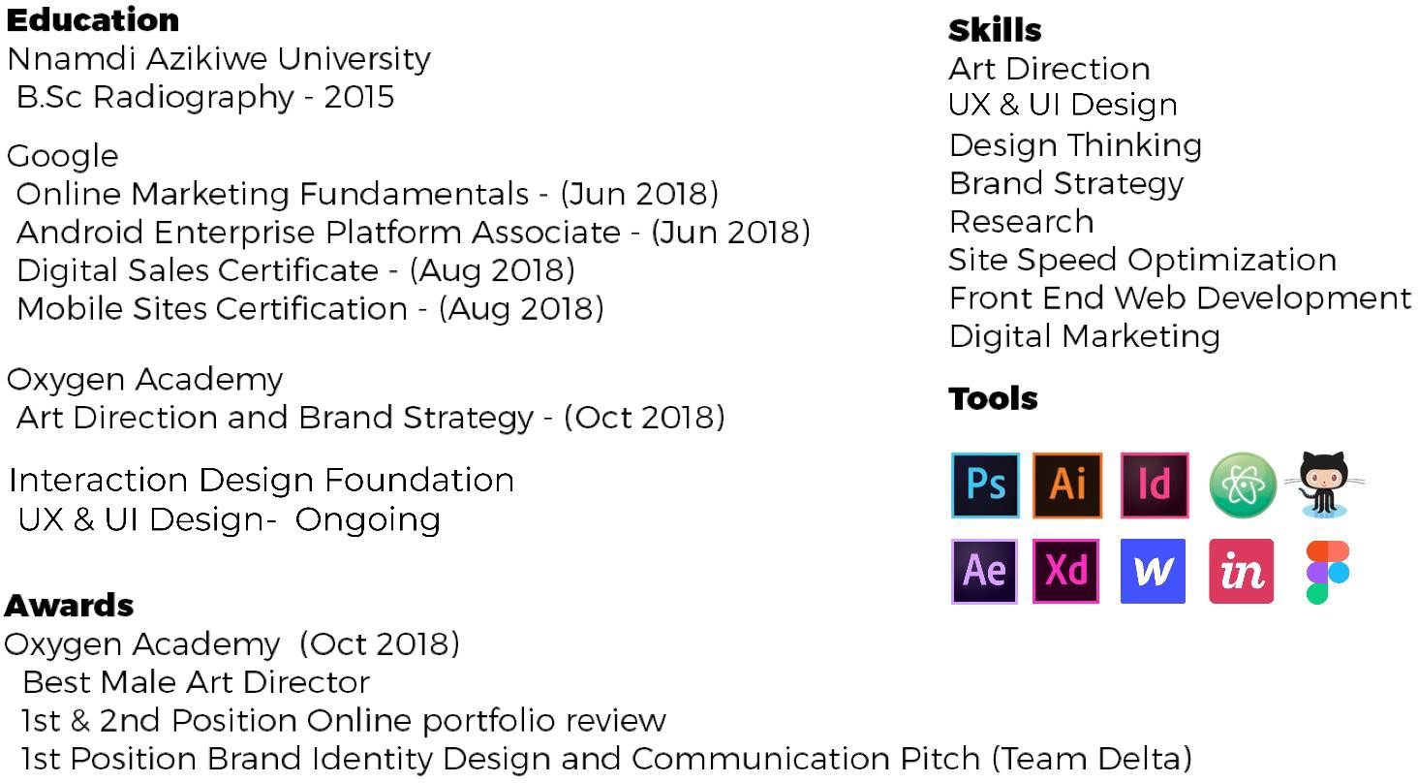

Slide 3
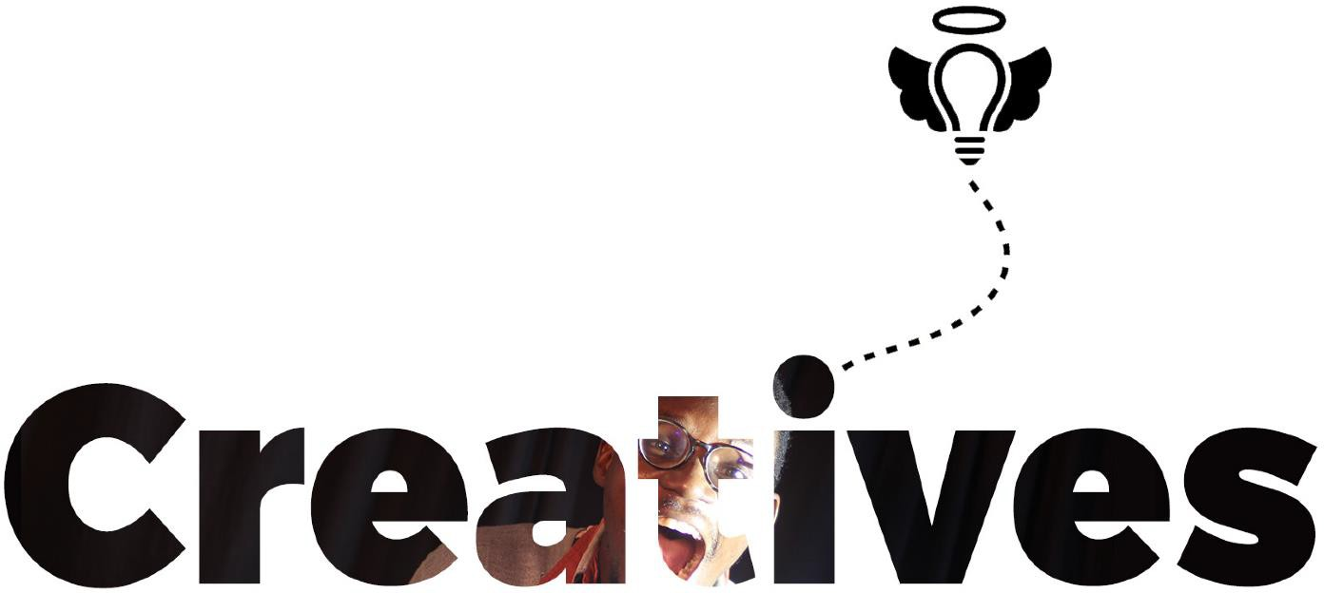

Slide 4
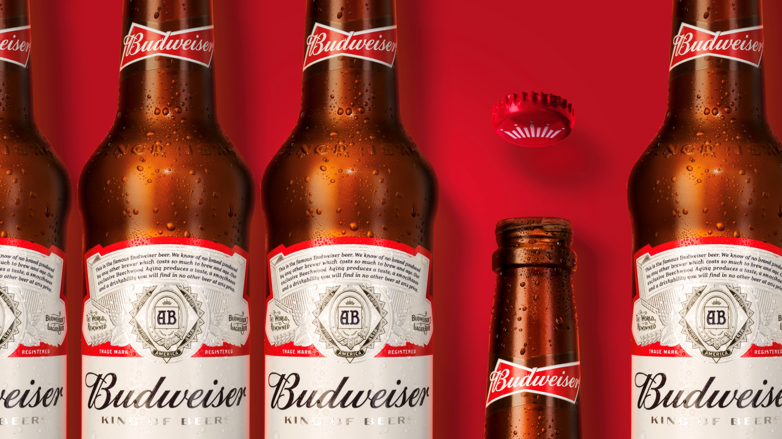

Slide 5
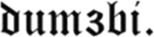

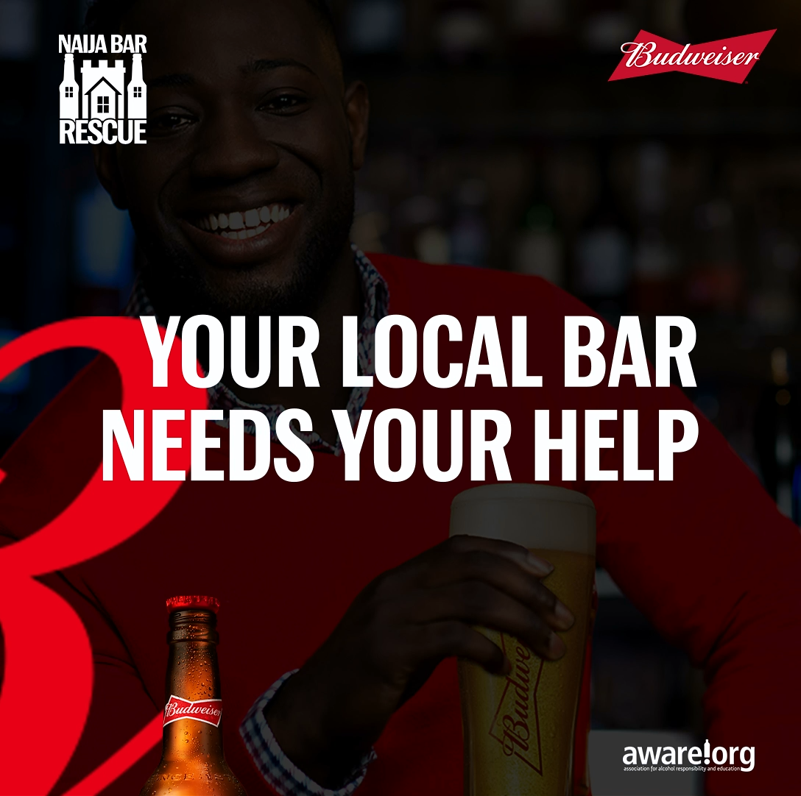

Budweiser
Brand:
Role:
Art Director,
Graphic Designer
Type:
Graphic Design, Motion Graphics and UI Design
CLICK TO PLAY

Slide 6
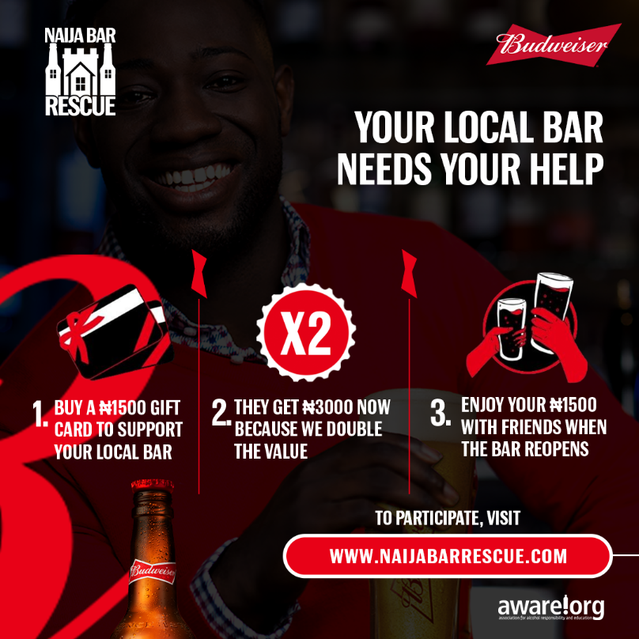
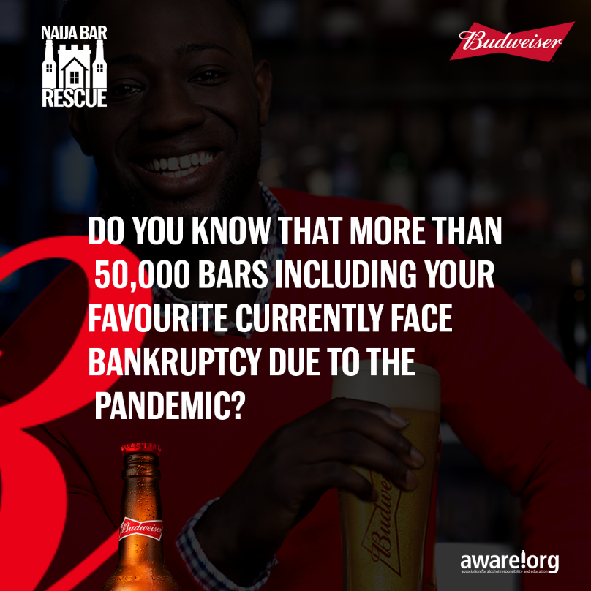
Budweiser
Brand:
Role:
Art Director,
Graphic Designer
Type:
Graphic Design, Motion Graphics and UI Design

Slide 7
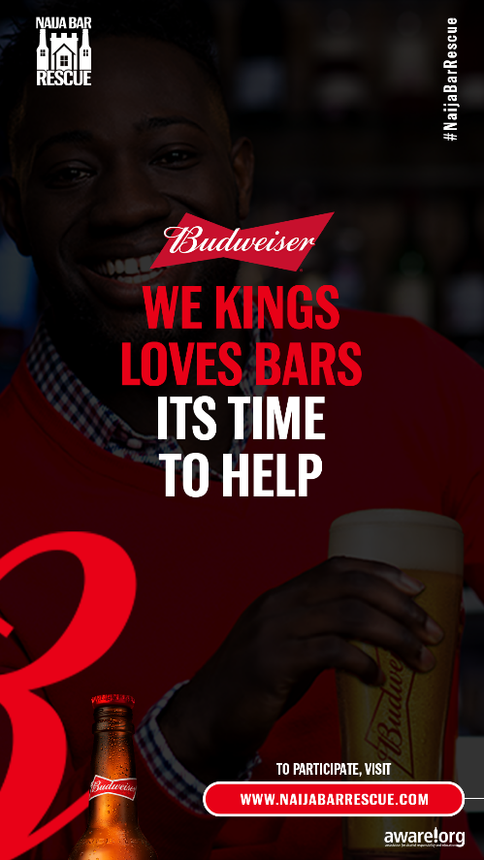
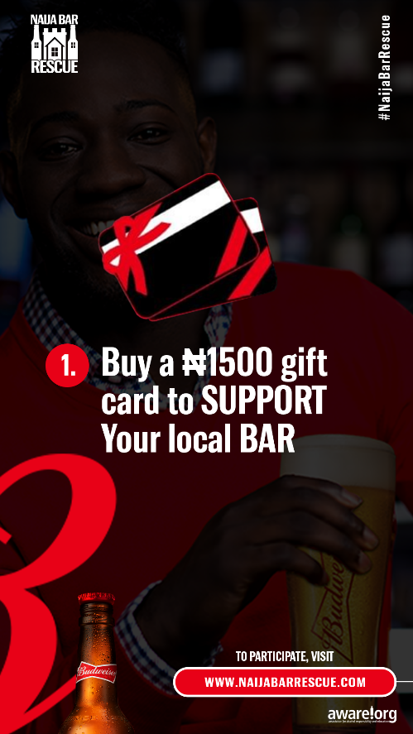
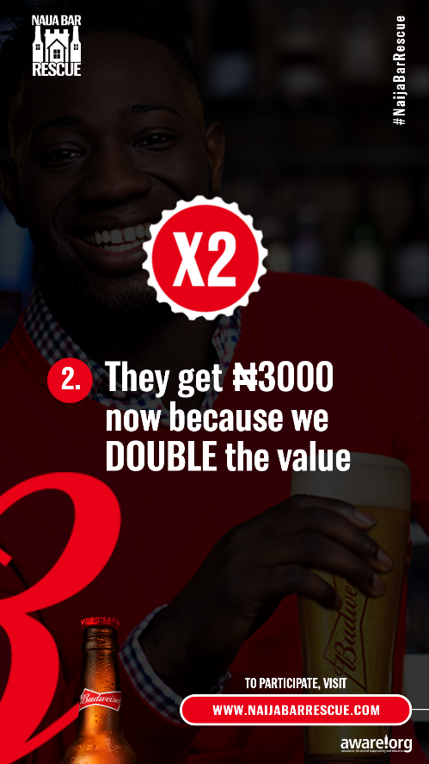
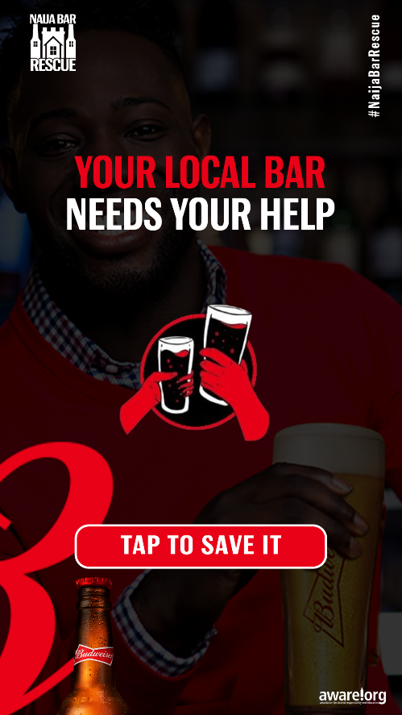
Budweiser
Brand:
Role:
Art Director,
Graphic Designer
Type:
Graphic Design, Motion Graphics and UI Design

Slide 8
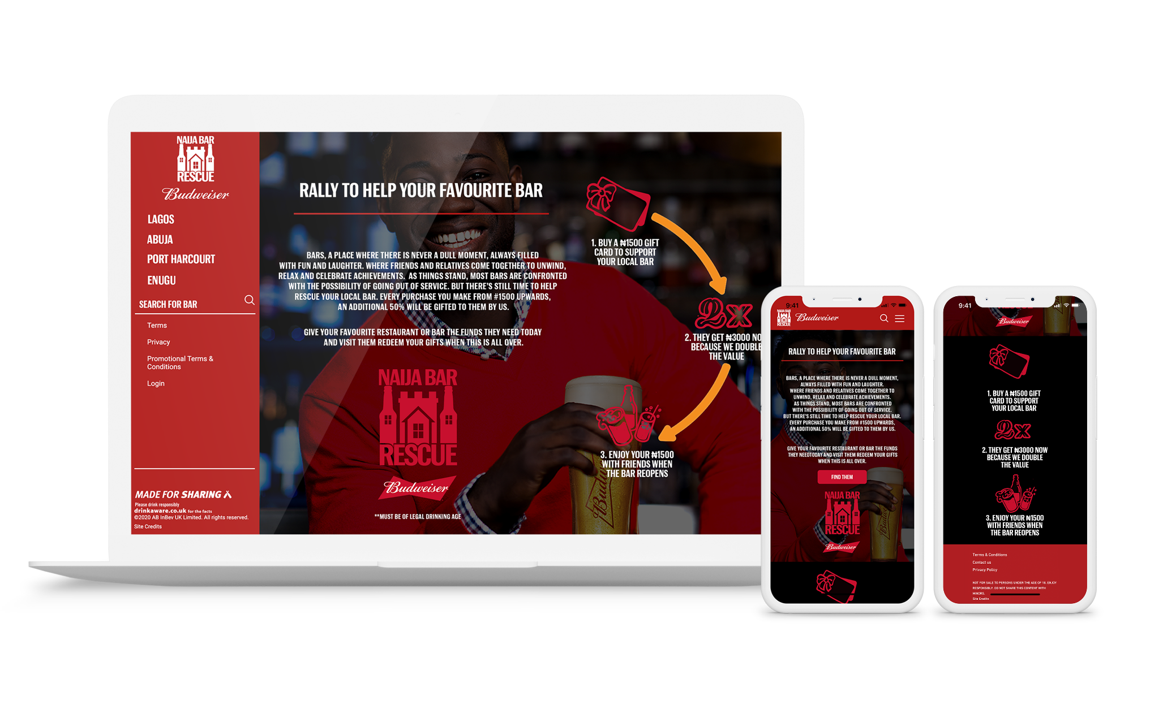
Budweiser
Brand:
Role:
Art Director,
Graphic Designer
Type:
Graphic Design, Motion Graphics and UI Design

Slide 9
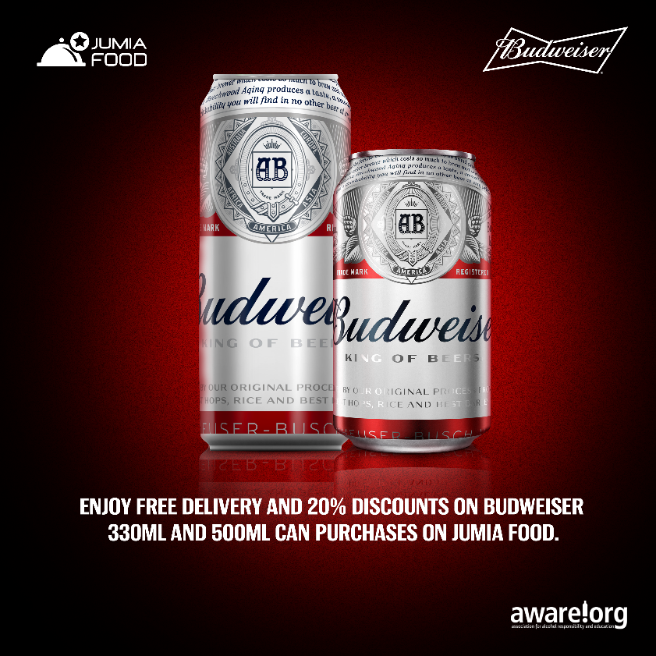
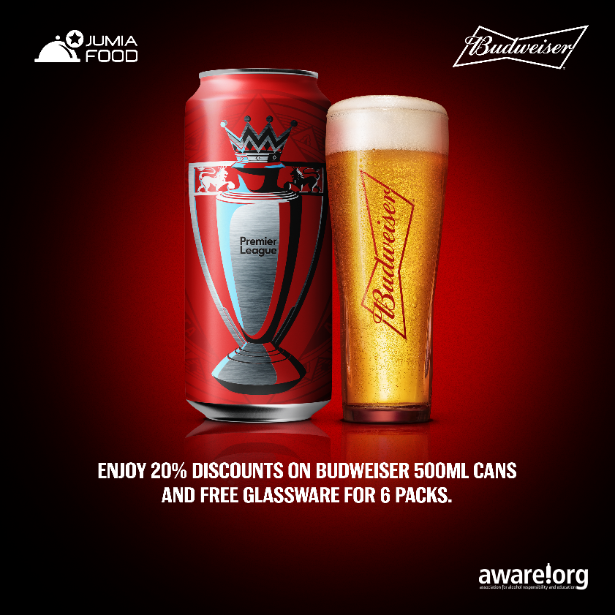
Budweiser
Brand:
Role:
Art Director,
Graphic Designer
CLICK TO PLAY
Type:
Graphic Design, Motion Graphics and UI Design
CLICK TO PLAY

Slide 10
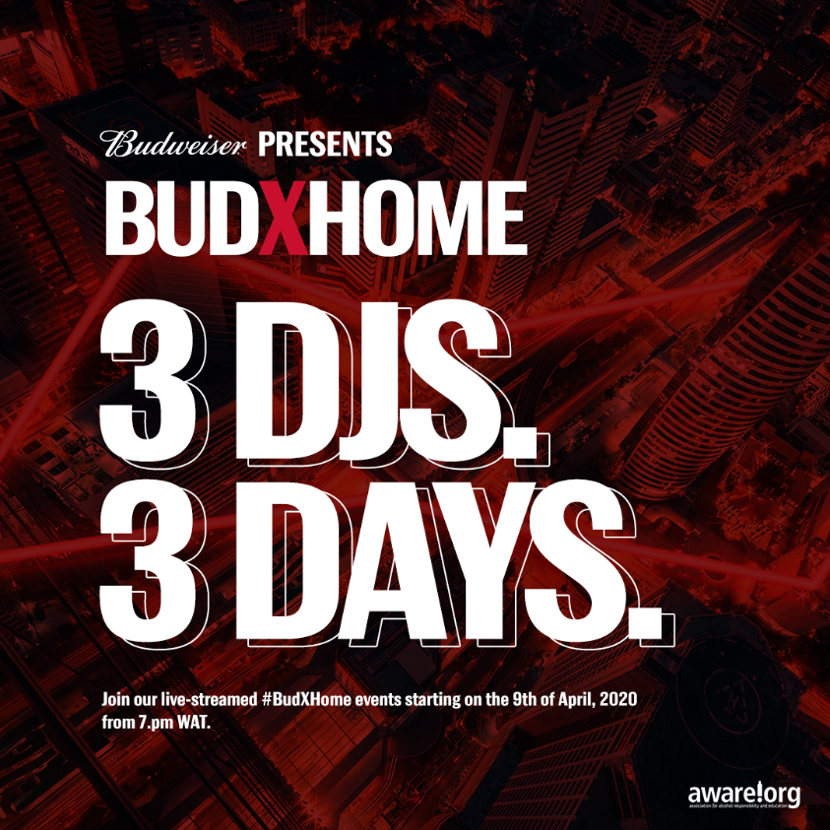
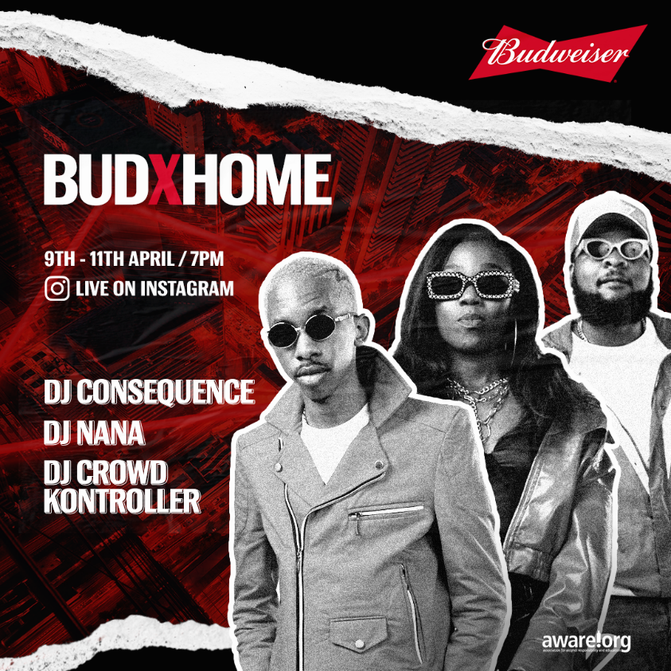
Budweiser
Brand:
Role:
Art Director,
Graphic Designer
Type:
Graphic Design, Motion Graphics and UI Design

Slide 11
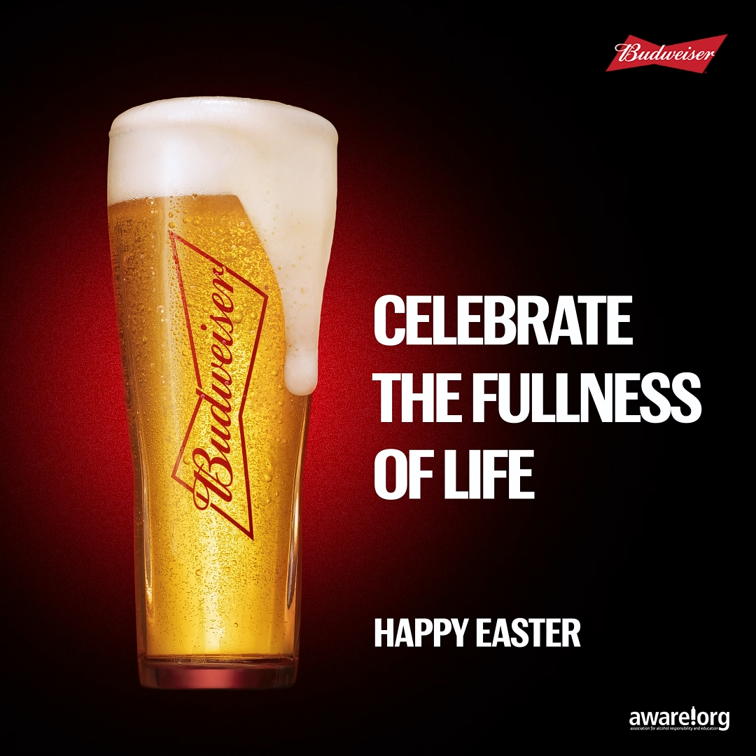
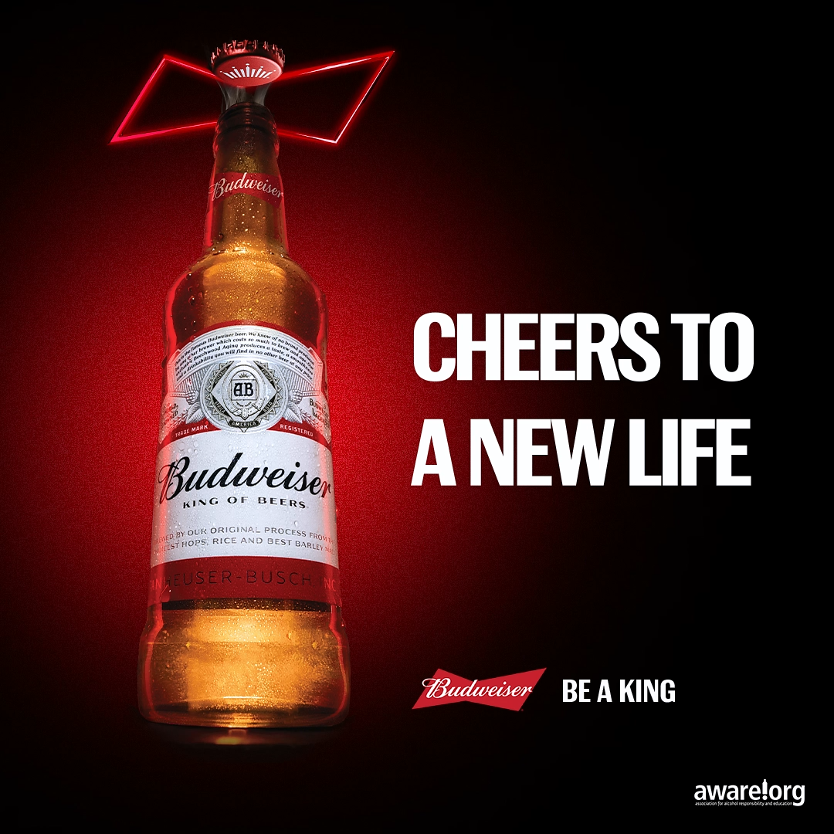
Budweiser
Brand:
Role:
Art Director,
Graphic Designer
Type:
Graphic Design, Motion Graphics and UI Design

Slide 12
Budweiser
Brand:
Role:
Art Director,
Graphic Designer
Type:
Graphic Design, Motion Graphics and UI Design

Slide 13
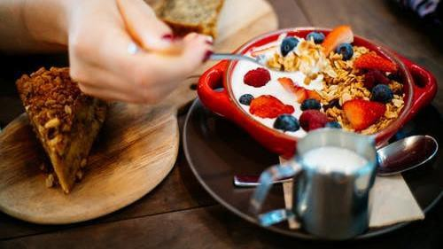
OBJECTIVE
To encourage the culture of Healthy Breakfast which wil also drive consumption and increase Top of Mind Awareness we developed a healthy breakfast chal enge
My role was to design the User interface of the App concept

Slide 14
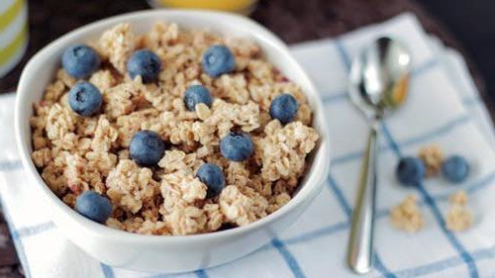
UX
After some user interviews
and task analysis
I did the Information architecture and defined the pages reqired for the app and the Wireframe

Slide 15
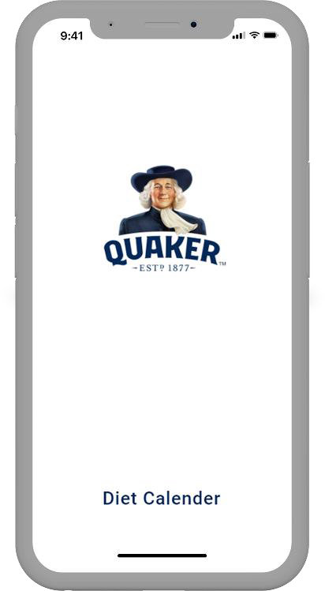
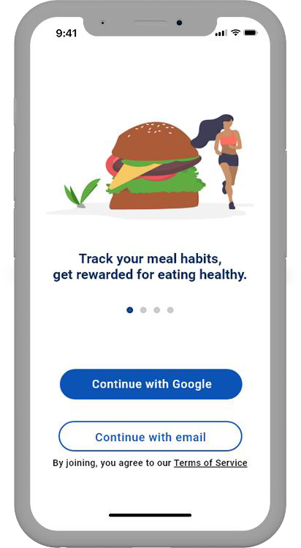


Splash page & onboarding page

Slide 16
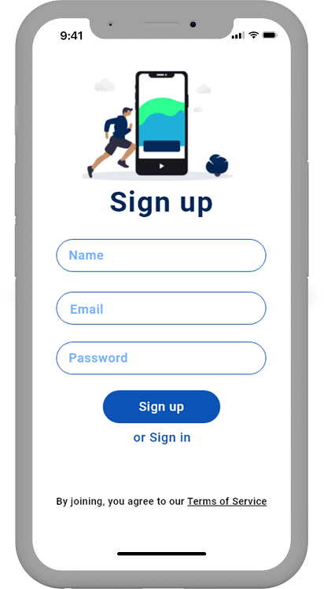
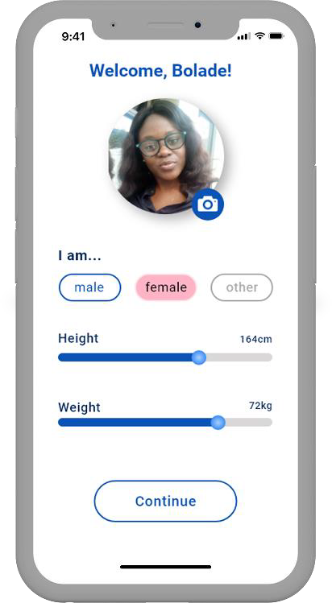


Sign up & profile update pages

Slide 17
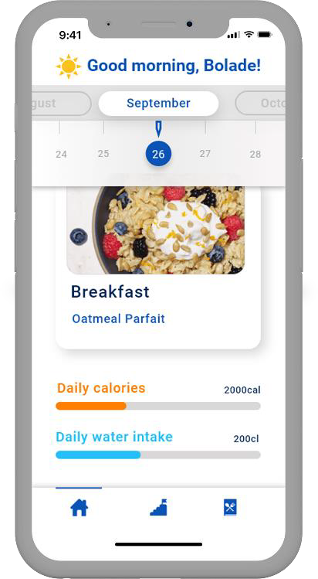
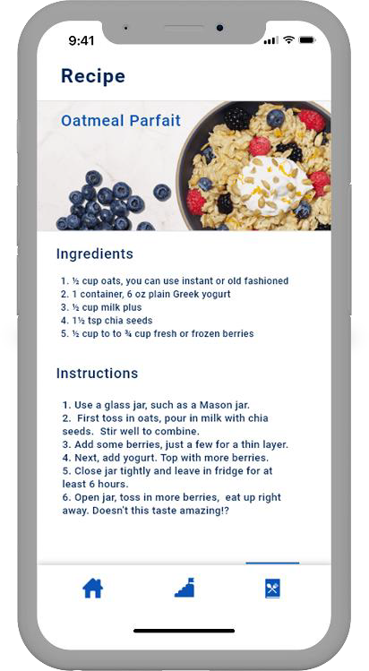
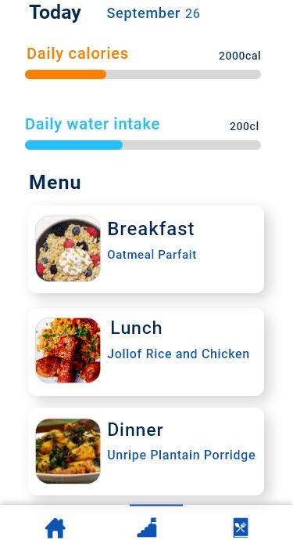


Daily diet dashboard & Menu pages

Slide 18
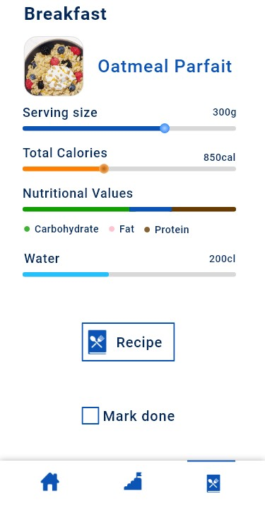


Meal & Recipe pages

Slide 19
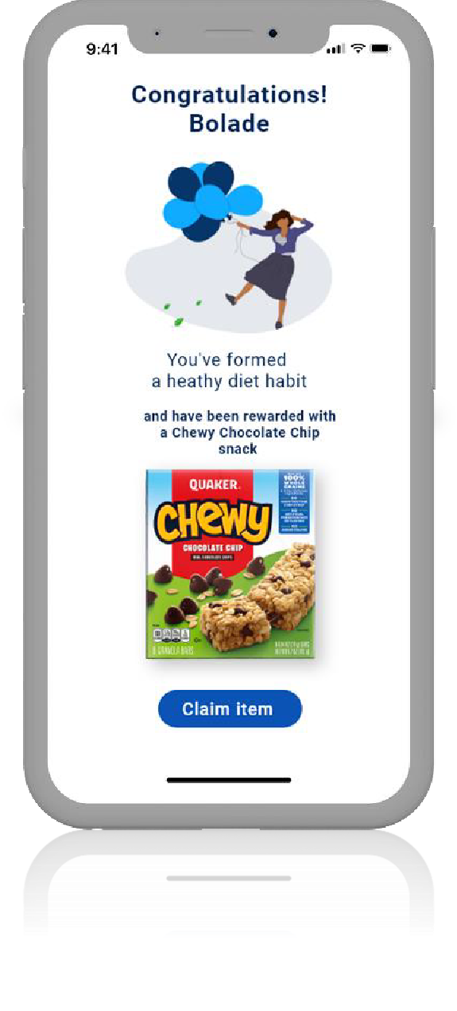

Reward page for following through with the challenge

Slide 20
